Slide 1



PRISMS Center Center for PRedictive Integrated Structural Materials Science
CASM Demo – Day 2
John C. Thomas, Brian Puchala, Anton Van der Ven Anirudh Natarajan, John Goiri, Min-Hua Chen, Max Radin, Jonathon Bechtel, Elizabeth Decolvenaere
PRISMS Center Workshop
August 15-17, 2016
Website: prisms-center.org

Slide 2
CASM Tutorial Outline
Yesterday (with John Thomas):
Crystal structure identification & specification
Symmetry analysis
Using CASM to manage data
Configuration selections and query syntax
Maintaining sanity with cluster expansion profiles
Cluster expansion basics
Configuration enumeration
Cluster expansion basis sets & correlation evaluation
Today:
Parameterizing cluster expansions
Predicting thermodynamic properties with grand canonical Monte Carlo
Free energy integration and phase diagram construction

Slide 3
CASM: Clusters Approach to Statistical Mechanics
First-principles energies of a “few” excitations
Extrapolate to
all other excitations
Lattice Model Hamiltonian
Monte Carlo
Thermodynamics

Slide 4
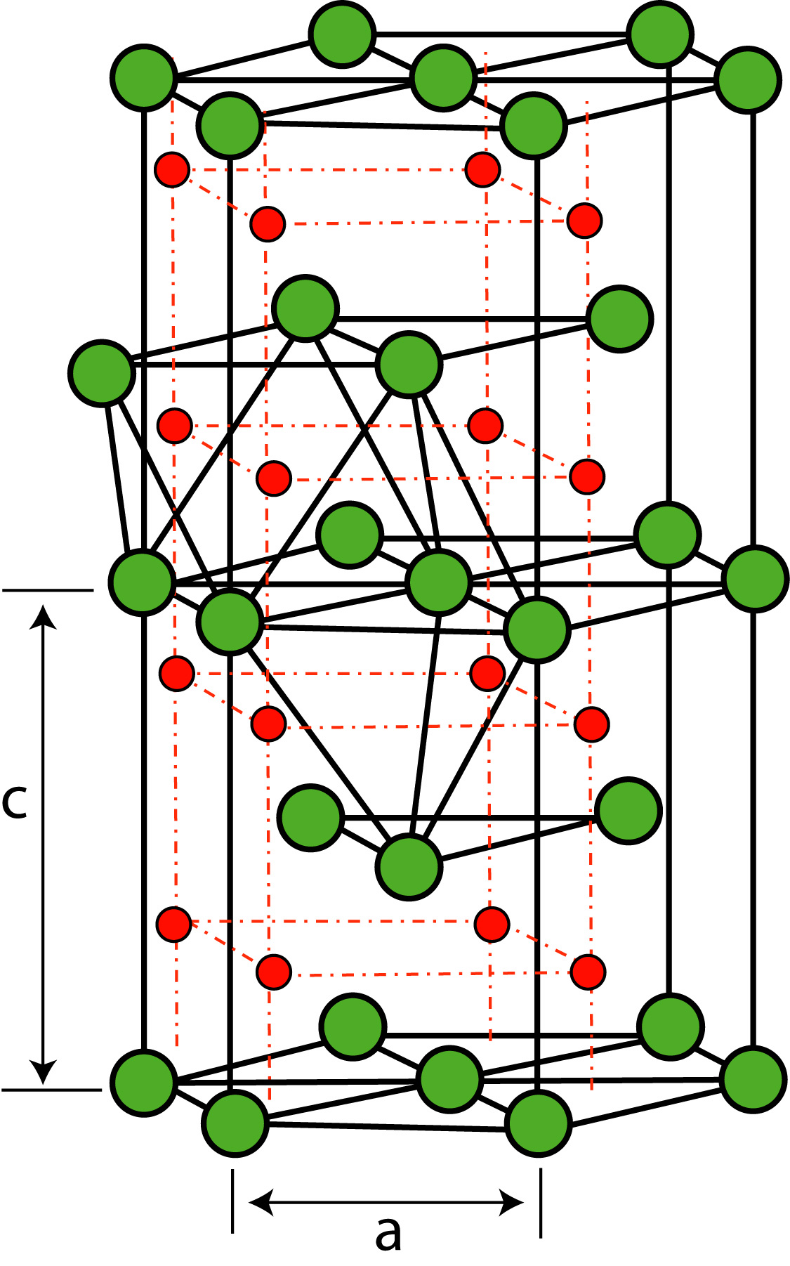
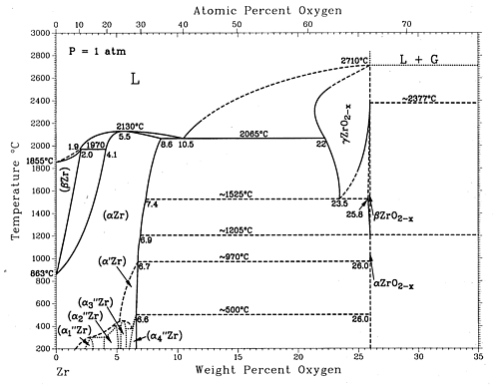
Zr-O binary system
Zr:
Very high O solubility
ZrO_{x}
Series of suboxide phases
ZrO_{2-x}
Oxide
J.P. Abriata, J. Garcés, and R. Versaci, Bulletin of Alloy Phase Diagrams Vol. 7 No. 2 1986 .

Slide 5
From yesterday...
Initialize project
Calculates symmetry, composition axes
Select composition axes
Enumerate supercells and configurations
Calculate configuration energies
Set reference states

Slide 6
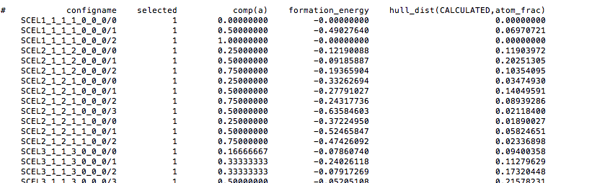
Query calculation results
'casm query -c CALCULATED -k 'comp formation_energy hull_dist(CALCULATED)'
--output <filename> to output to file

Slide 7
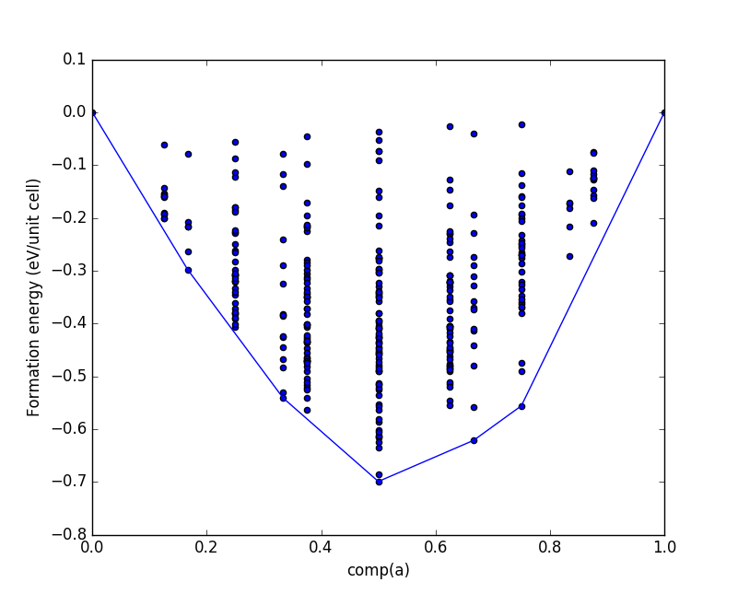
Plot calculation results, via Python
from casm.project import Project, Selection
import matplotlib.pyplot as plt
# construct a 'Selection'
proj = Project()
sel = Selection(proj, 'CALCULATED', all=False)
# query results into a pandas.DataFrame
comp = 'comp(a)'
Ef = 'formation_energy'
hull_dist = 'hull_dist(CALCULATED,atom_frac)'
sel.query([comp, Ef, hull_dist])
# get convex hull configurations,
# sorted for nice plotting
df = sel.data.sort_values([comp])
hull_tol = 1e-6
df_hull = df[df[hull_dist] < hull_tol]
print df_hull.to_string()
# plot formation energies with convex hull
plt.scatter(sel.data[comp], sel.data[Ef],
marker='o')
plt.plot(df_hull[comp], df_hull[Ef], 'b.-')
plt.xlabel(comp)
plt.ylabel('Formation energy (eV/unit cell)')
plt.xlim([0.,1.])
plt.show()

Slide 8
The Cluster Expansion
σ₁₅
σ₁₆
σ₁₇
Interactions between sites are described by products of σ_{i} .
Fit interaction parameters to a database of DFT energies.
σ₁₄
σ₅
σ₆
σ₁₈
σ₁₃
σ₄
σ₁
σ₇
σ₁₉
σ₁₂
σ₃
σ₂
σ₈
σ₁₁
σ₁₀
σ₉
E = J₁σ₁ + J_{1,7}σ₁σ₇ + J_{1,18}σ₁σ₁₈ + J_{1,17}σ₁σ₁₇ + J_{1,4,5}σ₁σ₄σ₅ + . . .
Then use symmetry to average over the entire crystal

Slide 9
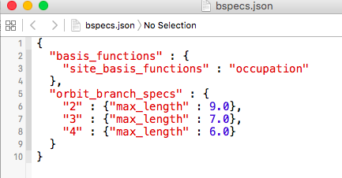
The bspecs.json file
Specifications for generating the cluster expansion basis functions

Slide 10
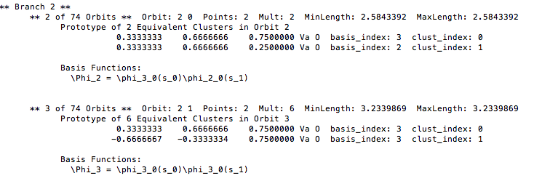
Viewing cluster basis functions
'casm bset –functions' will print basis function formulas

Slide 11
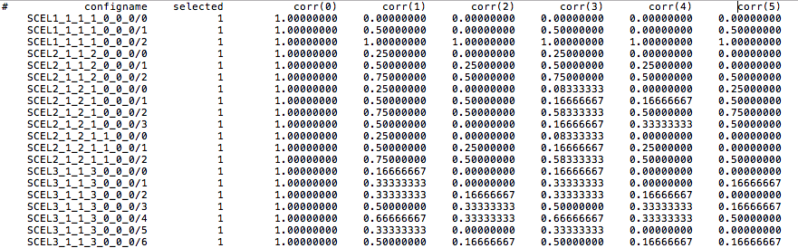
Query correlations
'casm query -k corr(0:5)'
will print correlations, , the symmetry-invariant basis function averages
Next step: Fit cluster expansion paramters, , to the DFT calculated energies

Slide 12
casm-learn
Acts as a wrapper around 'scikit-learn', the Python machine learning package, and incorporates some additional features:
Genetic algorithms, via 'deap', the Distributed Evolutionary Algorithm Package
Stores and compares potential results in a 'Hall Of Fame'
Convex hull checking
Generate casm selection files of configurations that you might want to calculate based on the cluster expansion
Writes 'eci.json' file containing calculated parameters
scikit-learn: http://scikit-learn.org
deap: http://deap.readthedocs.io

Slide 13
casm-learn: getting started
'casm-learn --help'
Print available options
'casm-learn --desc'
Print overall usage description
'casm-learn --exSomething'
Print example input files
'casm-learn –settings-format'
Print input file help
'casm-learn –s <filename>'
Run, using <filename> as the input settings file

Slide 14
Step 1) Problem specification
Solve X*b = y for b
X: 2d matrix of correlations
y: 1d vector of formation energies (or other property)
b: 1d vector, of fitting parameters, the effective clusters interactions (ECI)
Weighted least squares
X*b = y → L*X*b = L*y,
W = L*L^{T}, W typically being a diagonal matrix where the entries along the diagonal are the weights associated with each configuration

Slide 15
Step 1) Problem specification
Cross-validation:
Seperate data into several training and testing sets
For each training set, solve X^{train}*b = y^{train} for b
Use b to predict y^{test} = X^{test}*b for the remaining data
Calculate cross-validation score, root average MSE over test sets:
'casm-learn' can optionally add an additional 'penalty', p, to prefer results with fewer terms

Slide 16
Step 1) Problem specification
Cross-validation schemes:
KFold cross validation: split data into 'k' "folds"
Train the model on k-1 folds
Test on the remaining fold
CV score = Average score over each test fold
LeaveOneOut: k = number of configurations
ShuffleSplit:
Create 'n_iter' random splits of the data, with user control of the fraction of configurations in the train/test sets
Others:
http://scikit-learn.org/stable/modules/cross_validation.html#cross-validation

Slide 17
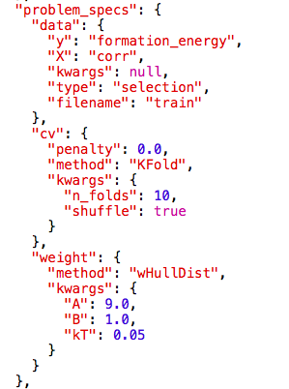
Step 1) Problem specification
name of a 'casm select' output file, or "CALCULATED", or "MASTER",
optional penalty per non-zero eci, as documented in
'casm-learn –settings-format'
scikit-learn class name and keyword arguments, as documented on scikit-learn.org
weighting method name and keyword arguments, as documented in
'casm-learn –settings-format'

Slide 18
Step 2) Estimator and Feature Selection Methods
Estimator:
determines how to solve for b, given X and y
Examples: LinearRegression, Lasso, Ridge
http://scikit-learn.org/stable/modules/linear_model.html
Feature Selection:
Determines which features (basis functions) to include in the model (which subset of b_{i} are non-zero)
Examples: GeneticAlgorithm, RFE (recursive feature elimination), SelectFromModel (used with Lasso, for example)
http://scikit-learn.org/stable/modules/feature_selection.html

Slide 19
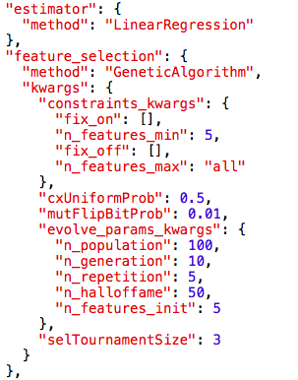
Step 2) Estimator and Feature Selection Methods
scikit-learn class name and keyword arguments, as documented on scikit-learn.org
scikit-learn class name or casm.learn.evolve class name and keyword arguments, as documented on scikit-learn.org and in 'casm-learn –settings-format'

Slide 20
Step 2) Estimator and Feature Selection Methods
Run 'casm-learn': 'casm-learn -s fit_1.json'
First time: stores problem specs in 'fit_1_specs.pkl'
First time, and subsequent times: Runs and stores results in 'fit_1_halloffame.pkl'
For a single problem specification, you may run repeatedly with the same or different estimator and feature selection methods
Individual results with best CV scores stored in hall of fame
View results: 'casm-learn -s fit_1.json --hall'
'--format type', with type=details, json, csv
'--indiv 0 1 ...', to only print particular individuals in the hall of fame

Slide 21
Step 3 / 4) Analyze Results, Run Monte Carlo
'casm-learn -s fit_1.json --checkhull'
Check if predicted ground state configurations agree with the DFT calculated ground state configurations
Print configuration selection files with configurations that you may want to calculate
Compare results from different problem specs
add more calculated configurations
select different training configurations
different weighting schemes
different CV schemes
Compare Monte Carlo results
'casm-learn –s fit.json –select 0' to write 'eci.json' file with ECI to use to evaluate the cluster expansion
Run Monte Carlo calculations and check phase stability predictions

Slide 22
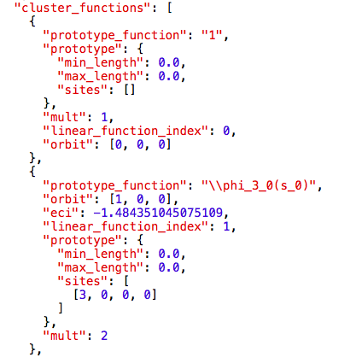
The 'basis.json'/'eci.json' file
Contains descriptions of the site basis functions (not shown) and cluster basis functions
The 'basis.json' file is generated when using 'casm bset –update'
The 'eci.json' file is a copy of the 'basis.json' file with "eci": value added to cluster functions with non-zero eci.

Slide 23
CASM: Clusters Approach to Statistical Mechanics
First-principles energies of a “few” excitations
Extrapolate to
all other excitations
Lattice Model Hamiltonian
Monte Carlo
Thermodynamics

Slide 24
Composition conversions
: #atoms per unit cell
: #atoms per unit cell at composition axes origin
: formula parameters determined from user specified composition axes
: conversion matrix
: left pseudo-inverse

Slide 25
Parametric chemical potential
Define:
: parametric chemical potential, along composition axes
- 'param_chem_pot' in casm input / output
: unit cell reference potential

Slide 26
Example: Binary alloy, no Va
First choice of composition axes:

Slide 27
Example: Binary alloy, no Va
Second choice of composition axes:

Slide 28
Ternary Alloy

Slide 29
Semi-grand canonical ensemble
By first & second laws, the fundamental equation is:
with a constraint on the total number of sites:

Slide 30
Characteristic potential in semi-grand canonical ensemble
And partition function:

Slide 31
Equations of state
Combining differentials of the fundamental equation and characteristic potential:

Slide 32
Thermodynamic Integration
Free energy:
Partition function:
: potential energy per unit cell
: ensemble average

Slide 33
Thermodynamic Integration
From free energy:
From the partition function and ensemble average:

Slide 34
Thermodynamic Integration
From free energy:
From the partition function and ensemble average:

Slide 35
Reference states
Low temperature expansion
At low T, only the lowest energy configurations (ground state, and most stable perturbations) will contribute to the partition function. Evaluate partition function explicitly by enumerating 1, 2, ... occupant perturbations. CASM implements the approximation with only 1 occupant perturbations.

Slide 36
Reference states
Dilute concentration:

Slide 37
Importance sampling
To numerically average thermodynamic quantities,
you don’t want to randomly sample from the 2^{N} possibilities
Instead you want to sample configurations
with their probability of occurrence

Slide 38
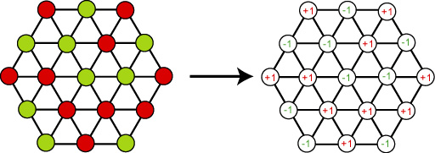
Metropolis Monte Carlo Algorithm
ΔΩ
Identify a possible change in configuration (add/remove/swap, etc.)
Calculate the associated change in potential energy, ΔΩ
Accept the move if :
ΔΩ < 0 or where R is a random number in range [0,1)
Increment the number of steps whether the change is accepted or not
Resulting average property values are ensemble averages

Slide 39
Monte Carlo output (Semi-grand Canonical)
Thermodynamic variables controlled in Monte Carlo (i.e. input)
Output from Monte Carlo

Slide 40
Monte Carlo output (Semi-grand Canonical)

Slide 41
Monte Carlo
See 'casm monte -h' and 'casm format --monte' for help setting up an input file.
The input file lets you specify:
The cluster expansion
Supercell and initial configuration
Pathway in space, with dependent or independent runs
Monte Carlo ensemble:
"grand_canonical" (only option currently) for semi-grand canonical ensemble
Monte Carlo method:
'metropolis' or 'lte1' (low temperature expansion)
Quantities to sample & convergence criteria
Enable saving configurations encountered during Monte Carlo into your configuration list

Slide 42
Monte Carlo Convergence
All quantities that are given a requested precision must first equilibrate, and then the estimated precision on the average must converge to the requested precision
A. van de Walle, M. Asta, Modell. Simul. Mater. Sci. Eng. 10, 521 (2002)

Slide 43
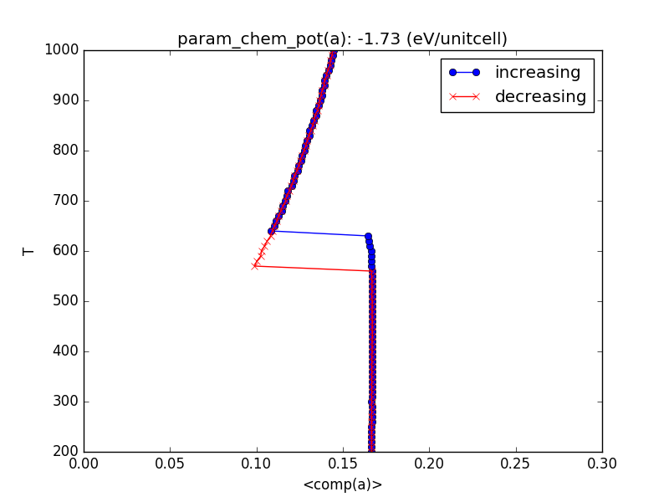
Phase diagram construction

Slide 44
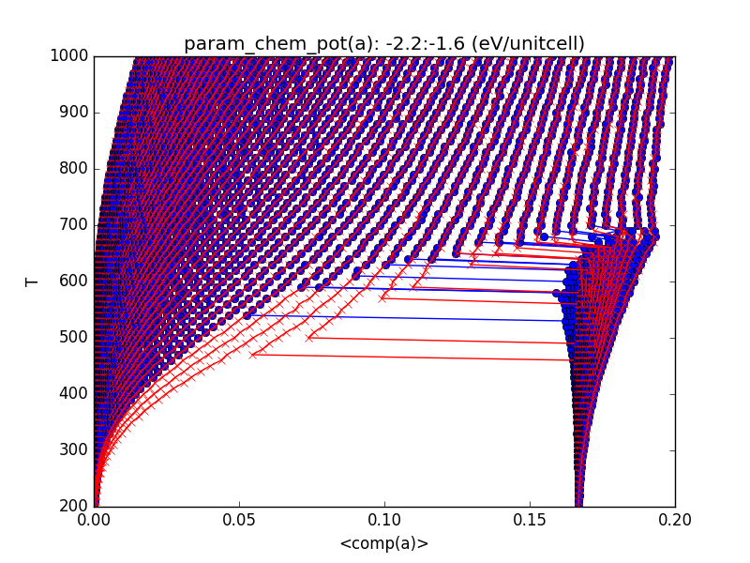
Phase diagram construction

Slide 45
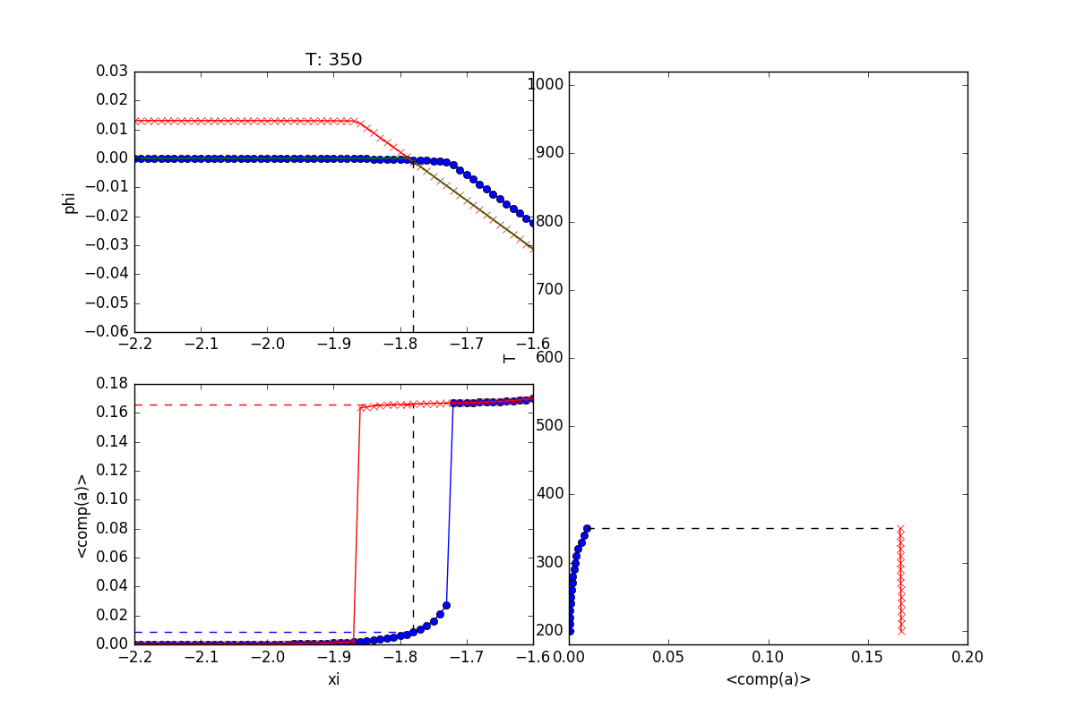
Phase diagram construction

Slide 46
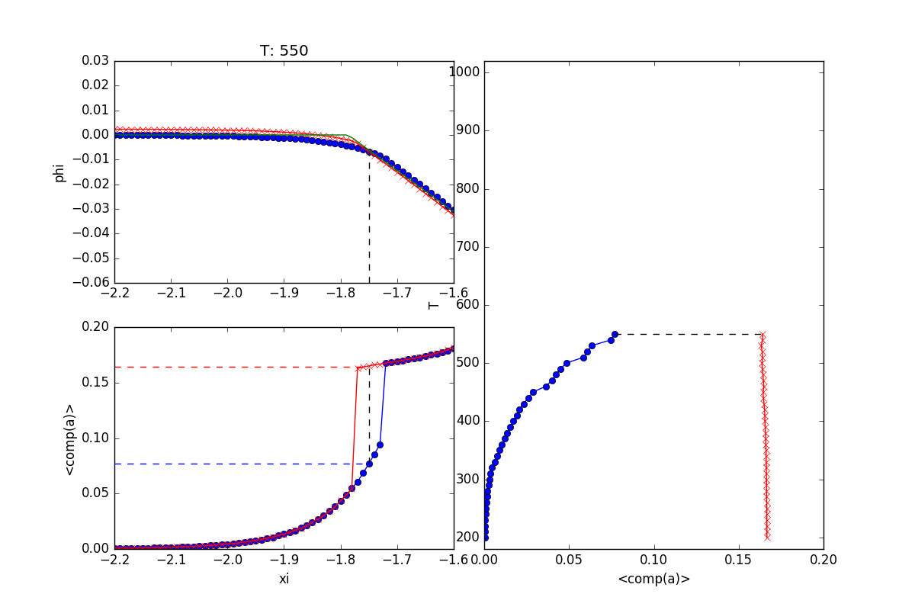
Phase diagram construction

Slide 47
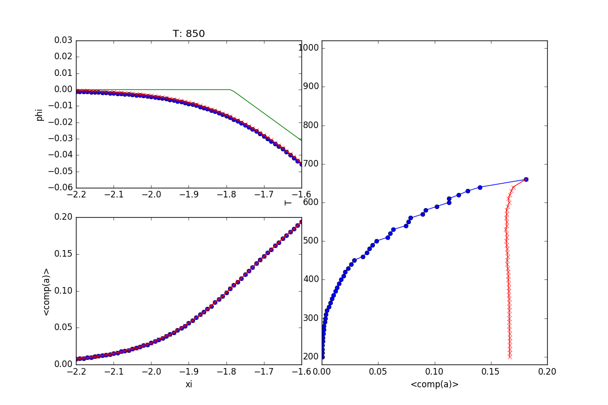
Phase diagram construction

Slide 48
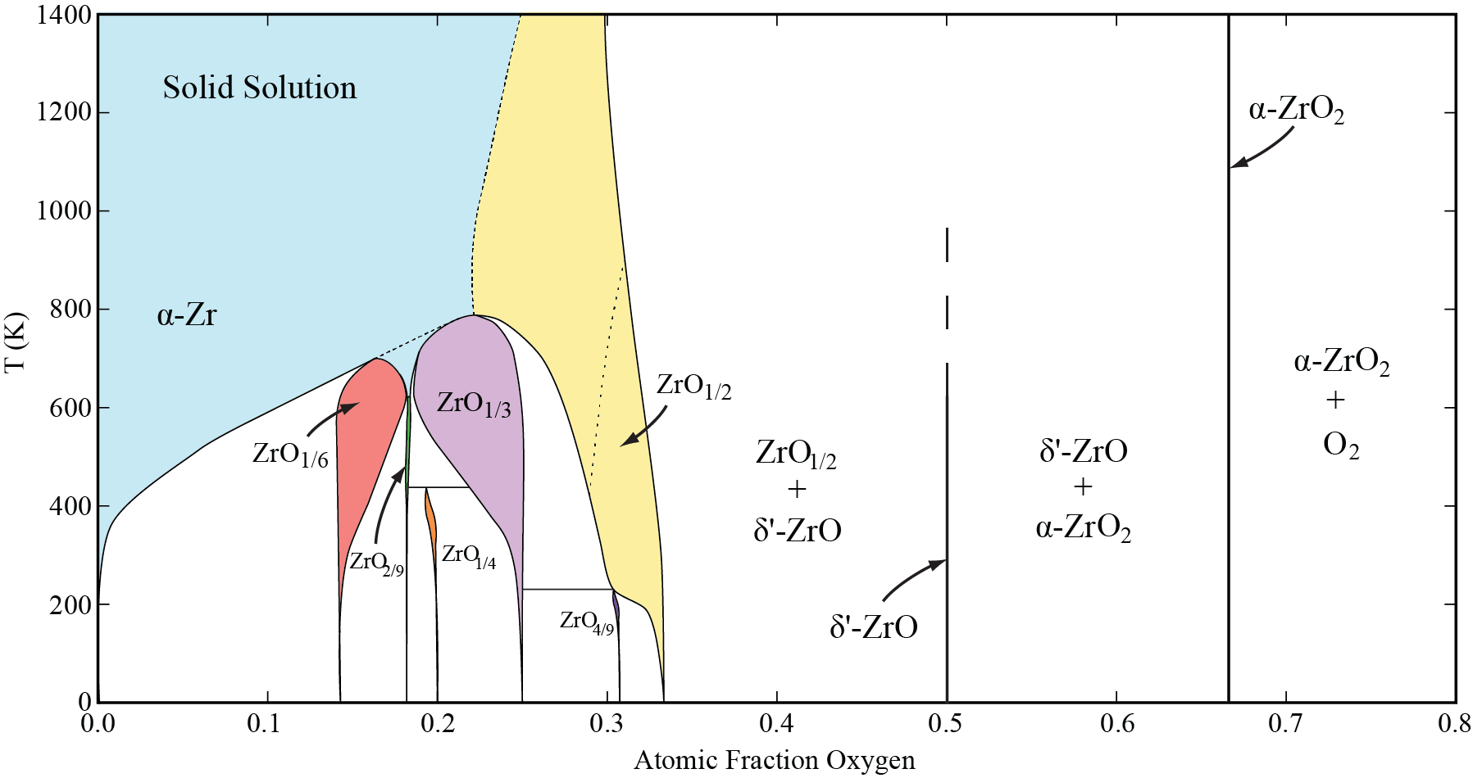
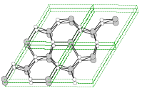
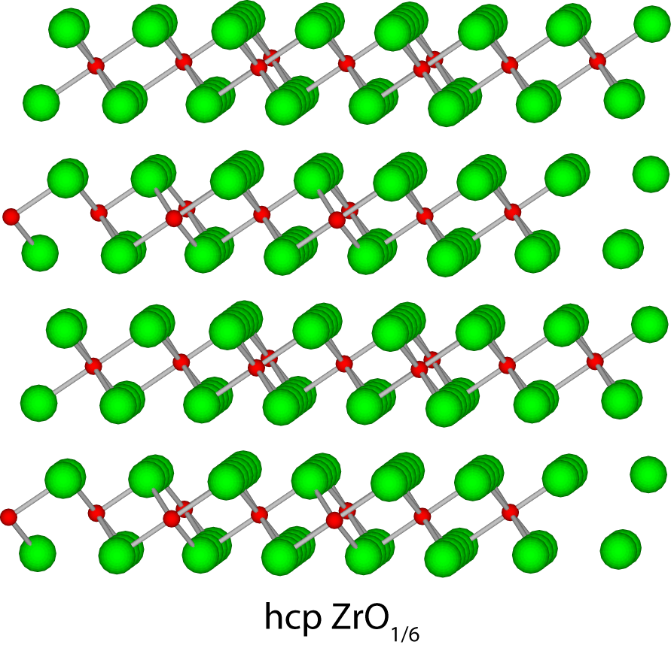
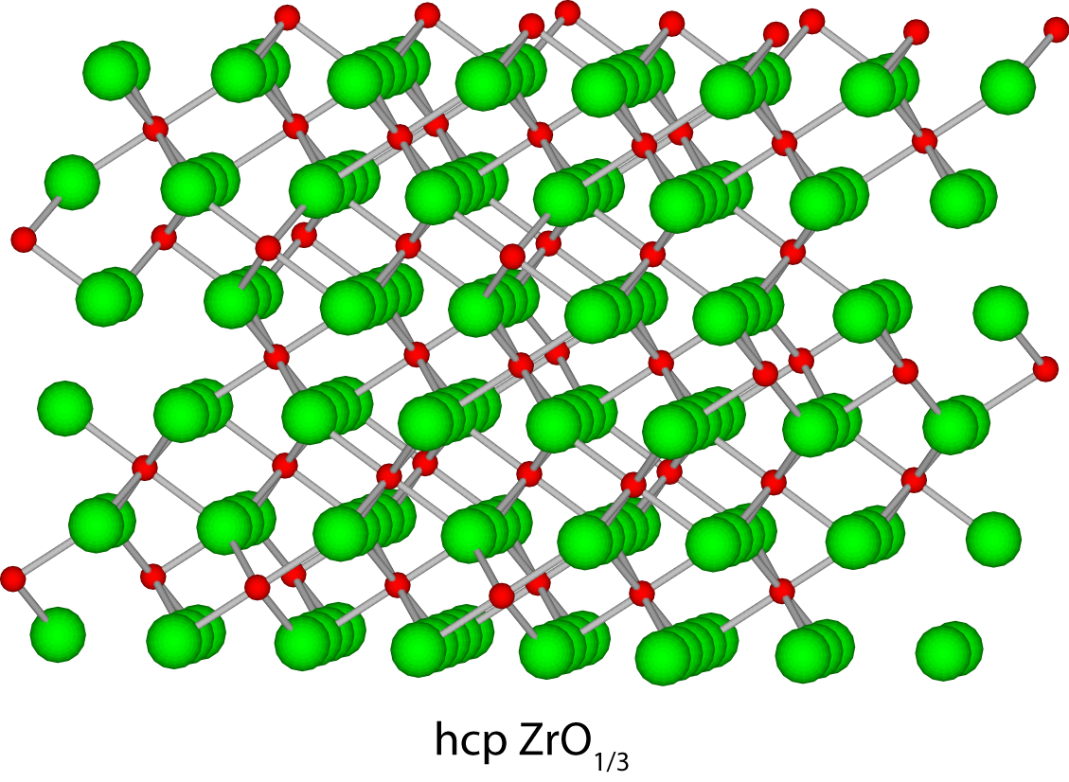
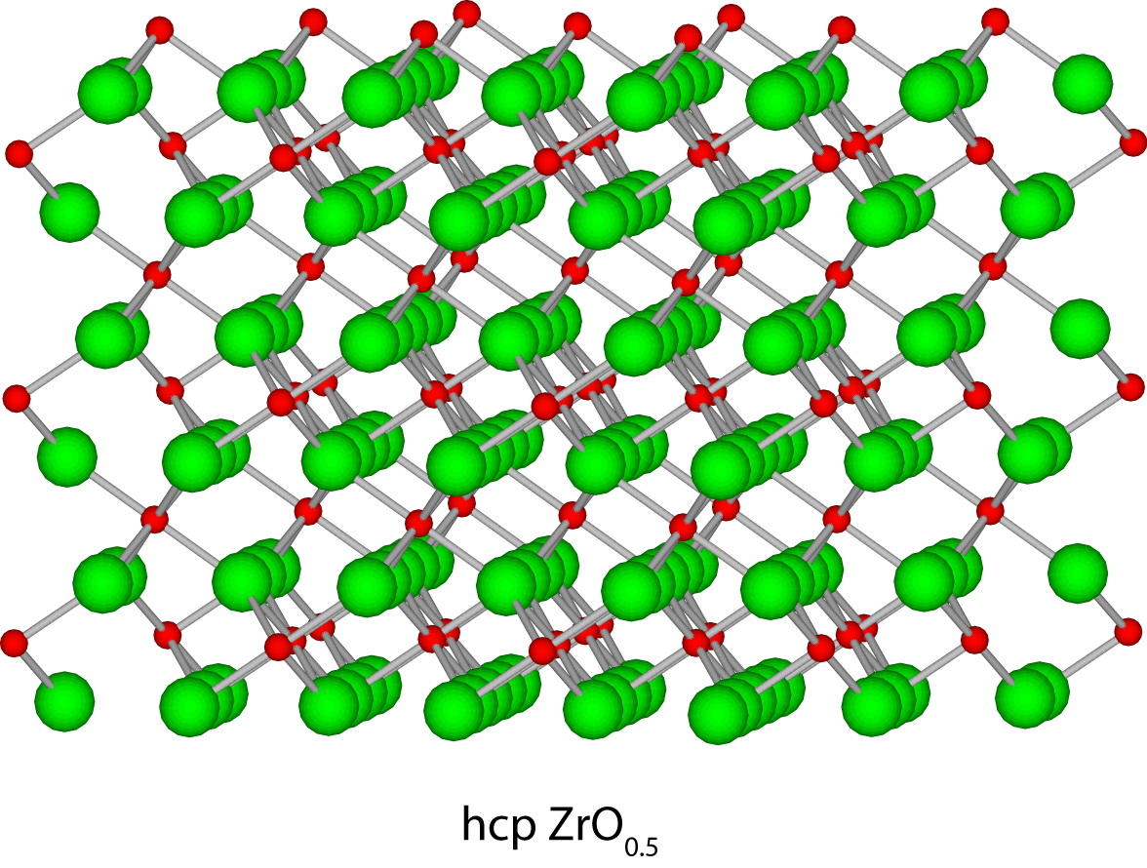
Calculated phase diagram
ZrO
ZrO_{1/6}
ZrO_{1/3}
ZrO_{1/2}

Slide 49
CASM Tutorial Outline
Yesterday (with John Thomas):
Crystal structure identification & specification
Symmetry analysis
Using CASM to manage data
Configuration selections and query syntax
Maintaining sanity with cluster expansion profiles
Cluster expansion basics
Configuration enumeration
Cluster expansion basis sets & correlation evaluation
Today:
Parameterizing cluster expansions
Predicting thermodynamic properties with grand canonical Monte Carlo
Free energy integration and phase diagram construction

Slide 50
